Slide 1
Chapter 2 System Simulation Chapter 3 Continuous System
Prepared By:
Sundar Kunwar
Assistant Professor
Department of Computer Science and Engineering
Nepal Engineering College

Slide 2
System Simulation
It is defined as the technique of solving problems by the observations of performance over time of a dynamic model of system.
This definition includes the use of dynamic physical models where the results are derived from physical measurements rather than numerical computations.

Slide 3
Monte Carlo Method
The Monte Carlo method is a numerical computational method which consists of experimental sampling with random number.
For example, the integral of a single variable over a given range corresponds to finding the area under the graph representing the function. Suppose the function f(x0) is positive and has lower and upper bound a and b respectively and the function is bounded above by the value c. The graph of the function is then contained within a rectangle with sides of length (b-c) and c.
If we are pick points at random within the rectangle and determined whether they lie beneath the curve or not, it is apparent that, providing the distribution of selected points is uniformly spread over the rectangle, the fraction of points falling on or below the curve should be approximately the ratio of the area under the curve to the area of the rectangle.
If ‘N’ points are used and ‘n’ of them fall under the curve, then approximately

Slide 4

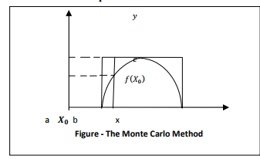

Slide 5
The accuracy improves as the number N increases. When it is decided that sufficient points have been taken, the value of integral is estimated by multiplying n with N by the area of rectangle i.e.)c(b-a).

Slide 6
Computational Technique
For each point, a value of ‘x’ is selected at random between a and b, say x0.
A second random selection is made between 0 and c to give Y. If Y0 is <=f(x0), the point is accepted in the count ‘n’, otherwise it is rejected and the next point is picked.
This method often based on integral of many variables by using a random number for each of the variables.

Slide 7
Monte Carlo application are sometimes classified as being simulation.
Simulation and Monte Carlo method are both numerical computational technique but the difference is that simulation applies to dynamic model whereas MonteCarlo technique applied to static model.

Slide 8
Problems Depicting Monte Carlo Method
Monte Carlo Simulation is that it is an approximate technique.
Like most methods based on probability theory, Monte Carlo methods are data‐intensive.
Monte Carlo methods cannot be used to conclude that the considered risks are no larger than a particular level.

Slide 9
Comparison of Simulation and Analytical Method:
The main drawback of simulation is: -
It gives specific solution rather than general solution. For example, in the study of automobiles wheel, an analytical solution gives all the condition that can cause oscillation. But each execution of a simulation only tells whether a particular set of condition did or did not cause oscillation. To try to find all such condition required that the simulation be repeated under many different condition.
The step by step nature of the simulation technique means that the amount of computation increases very rapidly as the amount of detail increases. Coupled with the need to make many runs, the simulation model result in extensive amount of computing.
Many simulation runs may be needed to find a maximum and yet leave undecided the question of whether it is a local or global maximum.

Slide 10
Drawback of Analytical Technique
The drawback of analytical techniques are:
The range of problem that can be solve mathematically is limited. Mathematical technique requires that the model be expressed in some particular format. For example, in the form of linear algebraic equation and continuous linear differential equation.
There are many simple limitation on a system such as physical stock, finite time delays or non-linear forces which makes a soluble mathematical model insoluble. But simulation removes this limitation.

Slide 11
Progress of simulation study:-
An initial state is to describe the problem to be solved in a concise manner so that there is a clear statement of what question are being asked and what measurements need to be taken in order to answer those question.
Based on this problem definition a model must be defined.
A possible solution is to explore to pass the model that can be solved analytically.
The result will help to guide the simulation technique.
When it is decided to simulate, we must plan the study by deciding upon the major parameters to be varied, the no. of cases to be conducted and order in which runs are to be made.
Given that, the simulation is to be on a digital computer and its program must be written. The next stage is, executing a series of runs according to the study plan

Slide 12
.The main value of the early runs in a simulation study is to get insight in to general behaviour of the system and to know which parameters are important for the system.
This may lead to reassessment of the model then results are verified and if found reasonable, simulation stops. Given that, the simulation is to be on a digital computer and its program must be written.
The next stage is, executing a series of runs according to the study plan.
The main value of the early runs in a simulation study is to get insight in to general behaviour of the system and to know which parameters are important for the system.
This may lead to reassessment of the model then results are verified and if found reasonable, simulation stops.

Slide 13
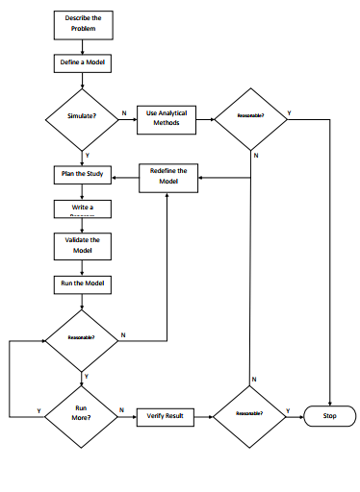

Slide 14
An initial state to describe the problem to be solved in a concise manner so that there is a clear statement of what questions to be asked and what measurements needed to be taken answer these questions.
Based on these problem definition a problem must be defines
A possible part explore the cost of a model that can be solved analytically the results in guiding the simulation study.
When it is decided to simulate we must plan the study by deciding upon the measure parameter to be varied the number of cases to be conducted and the order in which runs at to be made.

Slide 15
Given that the simulation is to be on a digital computer a program must be written. The next stage is executing runs to be study plans.
The main value of the early runs in a simulation study is to get inside into the general behaviour of the system and to know which Parameters are important for the system.
This may lead to re-assessment of the model, when results are verified and it found reasonable the simulation will be stopped.

Slide 16
Experimental Nature of Simulation
Simulation is an experimental problem solving technique.
Many simulation runs have to be made to understand the relationships involved in the system.
Therefore, the use of simulation in a study must be planned as a series of experiments.

Slide 17
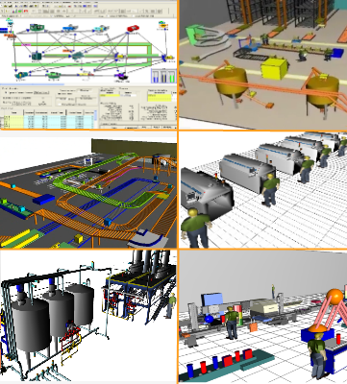
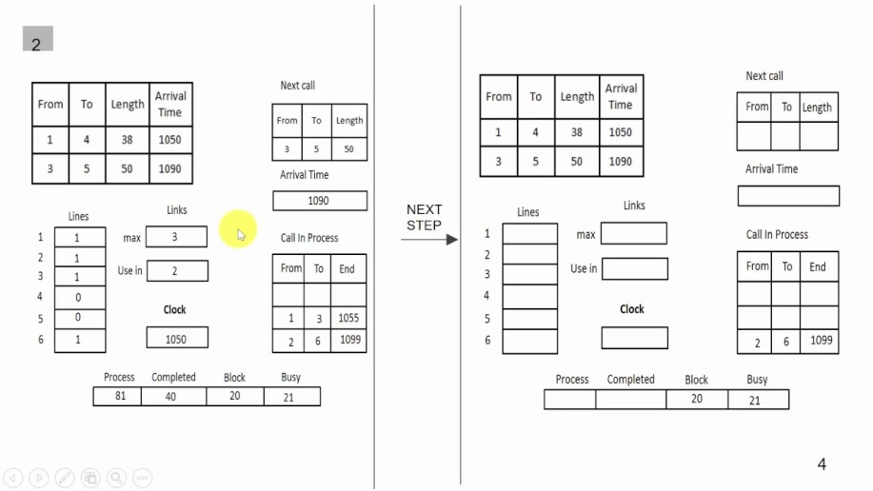
Types of System Simulation
There are basically two types of system simulation and they are:
Continuous System Simulation
Discrete System Simulation

Slide 18
Distributed Lag Model
In statistics and econometrics, a distributed lag model is a model for time series data in which a regression equation is used to predict current values of a dependent variable based on both the current values of an explanatory variable and the lagged (past period) values of this explanatory variable.
Those models which have the properties of changing only at fixed interval of time and basing current values of the variables on other current values and values that occurred in previous intervals are called Distributed Lag Model.

Slide 19
Distributed Lag Model
As an example, consider the following simple mathematical model of the national economy.
C=20+0.7(Y-T)…………………….i
I=2+0.1Y……………………………….ii
T=0.2Y………………………………….iii
Y=C+I+G………………………………iv
where
C be the Consumption
I be the Investment
T be the Taxes
G be the government expenditure
Y be the national income
This is a static model and can be made dynamic by lagging all the variable as follows:
I=2+0.1Y-1
T=0.2Y-1
Y=C-1+I-1+G-1
C=20+0.7(Y-1-T-1)

Slide 20
Cobweb Model
The cobweb model or cobweb theory is an economic model that explains why prices might be subject to periodic fluctuations in certain types of markets.
It describes cyclical supply and demand in a market where the amount produced must be chosen before prices are observed.
Producers' expectations about prices are assumed to be based on observations of previous prices.

Slide 21
Suppose for example that as a result of unexpectedly bad weather, farmers go to market with an unusually small crop of strawberries.
This shortage, equivalent to a leftward shift in the market's supply curve, results in high prices.
If farmers expect these high price conditions to continue, then in the following year, they will raise their production of strawberries relative to other crops.
Therefore, when they go to market the supply will be high, resulting in low prices.
If they then expect low prices to continue, they will decrease their production of strawberries for the next year, resulting in high prices again.

Slide 22
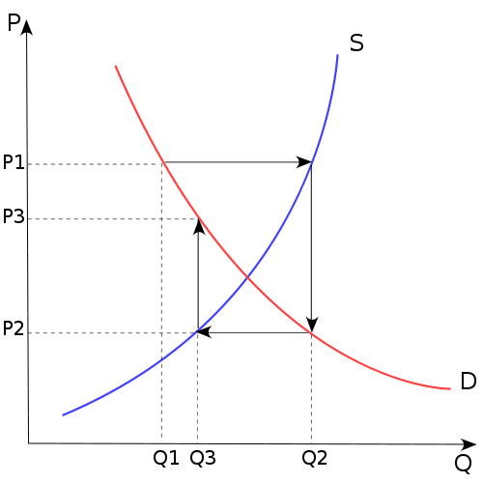

Slide 23
Time advancement Mechanism
Time in system simulation can be represented in advanced using following two commonly used techniques:
Fixed Interval Time
Event Occurring Time

Slide 24
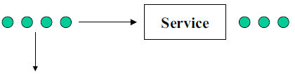

Definition of a queueing system
Departure of served customers
Customer arrivals
Departure of impatient customers
A queueing system can be described as follows:
"customers arrive for a given service, wait if the service cannot start immediately and leave after being served"
The term "customer" can be men, products, machines, ...

Slide 25
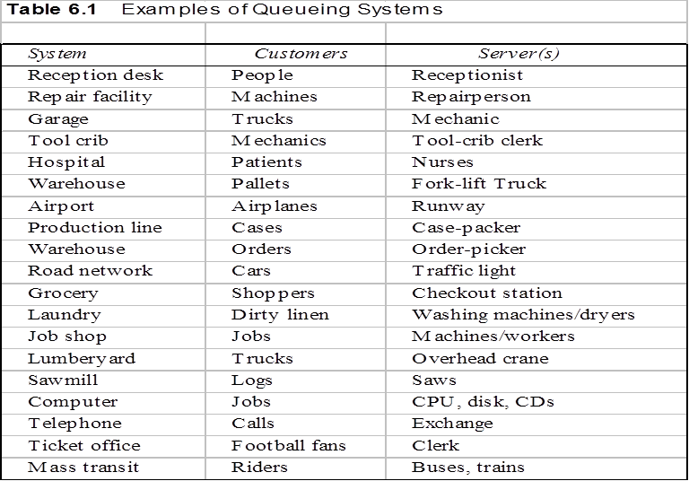
Examples

Slide 26
History of queueing theory
The theory of queueing systems was developed to provide models for forecasting behaviors of systems subject to random demand.
The first problems addressed concerned congestion of telephone traffic (Erlang, "the theory of probabilities and telephone conversations ", 1909)
Erlang observed that a telephone system can be modeled by Poisson customer arrivals and exponentially distributed service times
Molina, Pollaczek, Kolmogorov, Khintchine, Palm, Crommelin followed the track

Slide 27
Interests of queueing systems
Queueing theory found numerous applications in:
– Trafic control (communication networks, air traffic, …)
– Planing (manufacturing systems, computer programmes, …)
– Facility dimensioning (factories, ...)

Slide 28
Characteristics of simple queueing systems
Queueing systems can be characterized with several criteria:
Customer arrival processes
Service time
Service discipline
Service capacity
Number of service stages

Slide 29
Notation of Kendall
The following is a standard notation system of queuing systems
T/X/C/K/P/Z with
– T: probability distribution of inter-arrival times
– X: probability distribution of service times
– C: Number of servers
– K: Queue capacity
– P: Size of the population
– Z: service discipline

Slide 30

Customer arrival process
T/X/C/K/P/Z
T can take the following values:
– M : markovian (i.e. exponential)
– G : general distribution
– D : deterministic
– Ek : Erlang distribution
– …
• If the arrivals are grouped in lots, we use the notation T[X] where X is the random variable indicating the number of customers at each arrival epoch
– P{X=k} = P{k customers arrive at the same time}
• Some arriving customers can leave if the queue is too long

Slide 31

Service times
T/X/C/K/P/Z
X can take the following values:
– M : markovian (i.e. exponential)
– G : general distribution
– D : deterministic
– Ek : Erlang distribution
– …
k exponential servers with parameter μ
Erlang distribution E_{k} with parameter μ

Slide 32
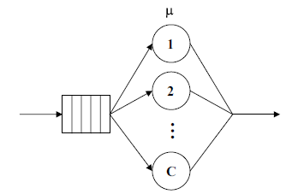
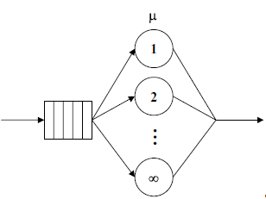
Number of servers
T/X/C/K/P/Z
In simple queueing systems, servers are identical

Slide 33
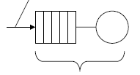
Queue capacity
T/X/C/K/P/Z
Loss of customers if the queue is full
Capacity K

Slide 34
Size of the population
T/X/C/K/P/Z
The size of the population can be either finite or infinite
For a finite population, the customer arrival rate is a function of the number of customers in the system: λ(n).

Slide 35
Service discipline
T/X/C/K/P/Z
Z can take the following values:
FCFS or FIFO : First Come First Served
LCFS or LIFO : Last Come First Served
RANDOM : service in random order
HL (Hold On Line) : when an important customer arrives, it takes the head of the queue
PR ( Preemption) : when an important customer arrives, it is served immediately and the customer under service returns to the queue
PS (Processor Sharing) : All customers are served simultaneously with service rate inversely proportional to the number of customers
GD (General Discipline)

Slide 36

The concept of customer classes
A queueing system can serve several classes of customers characterized by:
different arrival processes
different service times
different costs
service priority according to their class (preemption or no for example)

Slide 37
Simplified notation
We will use the simplified notation T/X/C when we consider a queue where:
The capacity is infinite
The size of the population is infinite
The service discipline is FIFO
• Hence T/X/C = T/X/C/∞/∞/FIFO

Slide 38
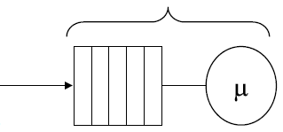
Single stage queueing systems
M/M/1 queue
N(t) : number of customers in the system
λ
Poisson arrivals
Exponentially distributed service tim

Slide 39
Performance measures of M/M/1 queue
Ls = Number of customers in the queue = ρ/(1−ρ) = λ/(μ−λ)
Ws = Sojourn time in the system = 1/(1−ρ)μ = 1/(μ−λ)
Lq = queue length = λ²/(μ−λ)μ = Ls − ρ
Wq = average waiting time in the queue = λ/(μ−λ)μ = Ws − 1/μ
ΤΗ = departure rate = λ
Server utilization ratio = ρ
Server idle ratio = P₀ = 1 - ρ
P{n > k} = Probability of more than k customers = ρ^{k+1}

Slide 40
M/M/C queue
Exponentially distributed service tim
λ
Poisson arrivals
N(t) : number of customers in the system
N(t) is a birth and death process with
The birth rate λ.
The deadth rate is not constant and is equal to N(t)μ if N(t) ≤ C and Cμ if N(t) > C.
Stability condition : λ< cμ.

Slide 41
Performance mesures of M/M/C queue
Ls = Number of customers in the system
= Lq + ρ
Ws = Sojourn time in the system
= Wq + 1/μ
Lq = Average queue length
=
Wq = Average waiting time
= Lq / λ
= Average number of busy server, π = ρ
U = Waiting probability
= π_{C} + π_{C+1} + ...
= π_{C}/(1-ρ/C)

Slide 42
Continuous System Simulation
Predominant-present as the strongest or main element.
“A Continuous system is one in which the predominant activities of the system cause smooth changes in the attributes of the system entities”.
When a system is modelled mathematically the variable of the model represents the attributes.
In Continuous system the relationship describes rates at which attributes changes, so changes that the model consists of differentiation equation.
For Example wheel suspension system of an Automobile.

Slide 43
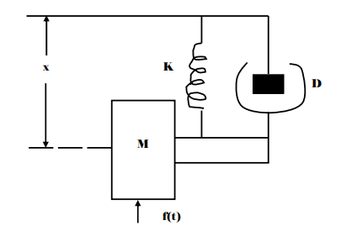
Automobile Wheel Suspension System

Slide 44
Automobile Wheel Suspension System..
This system represents the suspension of an automobile wheel when the automobile body is assured to be immobile in a vertical direction.
The figure represents a mass ‘M’ which is subject to an applied force F(t) varying with time.
A spring whose force is proportional to its extension or contraction given by ‘K’ and a shock absorber which exerts a damping force ‘D’ proportional to velocity of the mass.

Slide 45

Automobile Wheel Suspension System..
If we pick a point of the wheel as a reference point from which to measure the vertical displacement of the wheel, the variable ‘x’ represents the displacement of the point taking ‘x’ to be positive for an upward movement.
The velocity of the wheel in the vertical direction is the rate of change of displacement which is first differential.

Slide 46


Automobile Wheel Suspension System
The acceleration of wheel in the vertical direction is the rate of change of velocity which is second differential
for mass ‘M’ and applied force KF (t).The equation of motion in the absence of any other forces should be

Slide 47
Automobile Wheel Suspension System..
But the shock absorber exerts a resisting force that depends on the velocity of wheel. This force is represented by Dx, where ‘D’ is the measure of viscosity of the shock absorber.
The spring also exerts a resisting force which depends on the extend to which it has been compressed, represented by K(x), where ‘K’ is a constant defining a stiffness of the spring.
Since both these forces oppose the motion of wheel they are to be subtracted from the applied force to given following equation.

Slide 48

Automobile Wheel Suspension System..

Slide 49
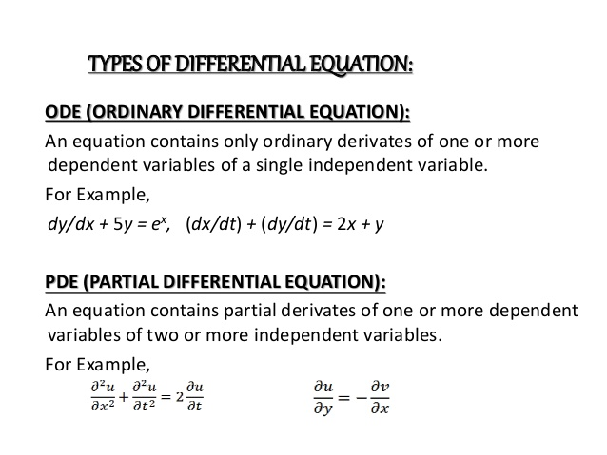

Slide 50
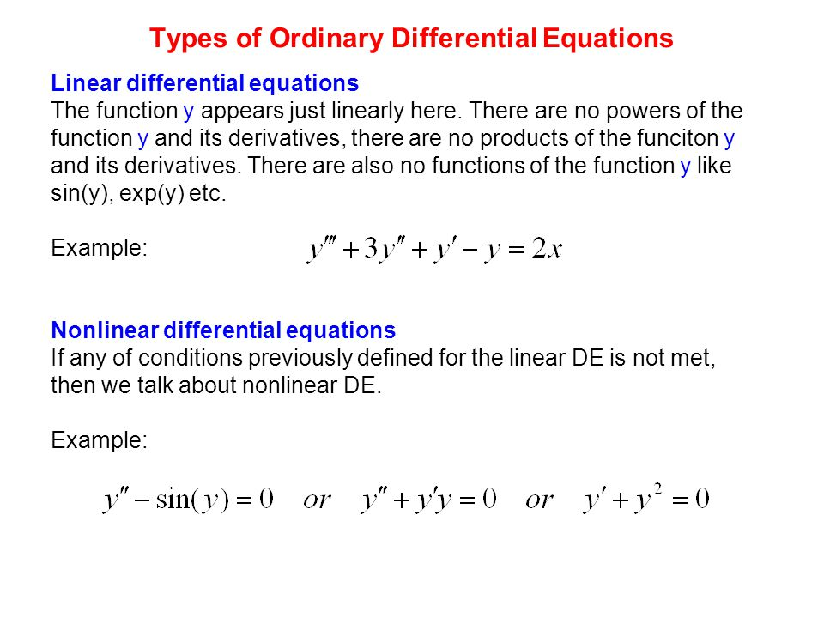

Slide 51
Analog Computer
An analog computer or analogue computer is a form of computer that uses the continuously changeable aspects of physical phenomena such as electrical, mechanical, or hydraulic quantities to model the problem being solved.
As an analog computer does not use discrete values, but rather continuous values, processes cannot be reliably repeated with exact equivalence, as they can with Turing machines. Unlike digital signal processing, analog computers do not suffer from the quantization noise, but are limited by analog noise.

Slide 52
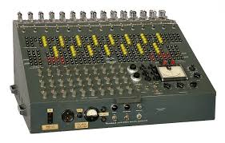

Analog computers

Slide 53
Analog Computer..
Key mechanical components might include rotating shafts for carrying data within the computer, miter gear differentials disc/ball/roller integrators, cams (2-D and 3-D), mechanical resolvers and multipliers, and torque servos.
Key electrical/electronic components might include:
Precision resistors and capacitors
operational amplifiers
Multipliers
potentiometers
fixed-function generators

Slide 54
Analog Computer
The core mathematical operations used in an electric analog computer are:
addition
integration with respect to time
inversion
multiplication
exponentiation
logarithm
division

Slide 55
Analog Methods
It is the method by which analog computers are designed.
Example:
Refer class materials

Slide 56
Hybrid Computers
Hybrid computers are computers that exhibit features of analog computers and digital computers.
The digital component normally serves as the controller and provides logical and numerical operations, while the analog component often serves as a solver of differential equations and other mathematically complex equations.
The first desktop hybrid computing system was the Hycomp 250, released by Packard Bell in 1961.
Another early example was the HYDAC 2400, an integrated hybrid computer released by EAI in 1963.
Late in the 20th century, hybrids dwindled with the increasing capabilities of digital computers including digital signal processors.

Slide 57
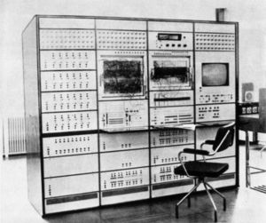

Slide 58
Digital Analog Simulator
Digital Analog Simulation (DAS) is a computer software which makes a digital computer operate much like an analog computer.
The application of the technique to programming an IBM 7090 computer is described.
Although it is not intended primarily as an analog computer simulator, the similarity of DAS programming to analog programming is readily apparent.
DAS combines remarkable ease and speed of programming with reasonably high computing speed.
The DAS input language is designed to permit a simple and concise description of an analog-style block diagram of the problem to be solved.
The blocks in the diagram are restricted to summers, integrators, multipliers, limiters, relays and other "components" for which 'macro-instructions appear in the DAS compiler.
The construction of a DAS block diagram is more straight-forward than an analog computer block diagram because there is virtually no restriction on the number of available components, and because no amplitude scaling is required.

Slide 59
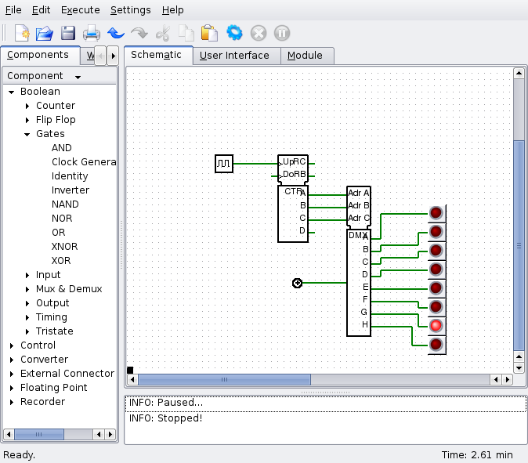

Slide 60
Continuous System Simulation Language
Continuous System Simulation Languages are high level languages which facilitates modeling and simulation of the system characterized by ordinary and partial differential equation.
Examples
Continuous System Simulation Program (CSMP)
Partial Equation Differential Language (PEDL)

Slide 61
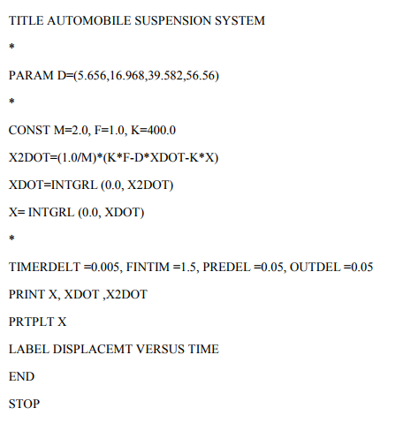
CSMPIII PROGRAM OF WHEEL SUSPENSION SYSTEM OF AN AUTOMOBILE

Slide 62
Continuous System Simulation Language (CSSL)
CSMP III, or Continuous System Modeling Program IlI is an early scientific computer software designed for modeling and solving differential equations numerically.
This enables real-world systems to be simulated and tested with a computer.
They use statement type of input for digital computer and allow a problem to program directly from an equation of mathematical model.
CSMP III It consists of three types of statement
1. Structural Statement
2. Data Statement
3. Control Statement
Structural Statement It defines the model; it consists of FORTAN like statement and functional blocks.
Data Statement They assign numerical value to parameters, constraints and initial conditions.
Control Statement They specify option’s in assembly an execution of the program & the choice of output.

Slide 63
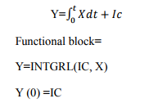
Structural statement,
X = (6.0*Y)/W+ (Z-2.0) **2.0
Functional blocks There are various functional block’s. 1. INTEGRATOR

Slide 64
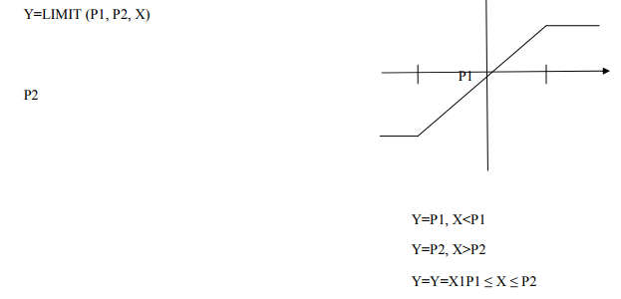
2. LIMITOR It is used to limit a function within some range.

Slide 65
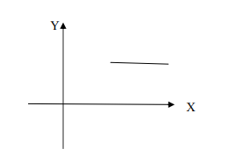
3. STEP FUNCTION
Y=STEP (P)
Y= Y=SIN(X)
Y=ABS(X)

Slide 66
2. DATA STATEMENT IN CSMP-III
It can be used to set the initial values of the integration function.
CONST A=0.5
PARAM It is used to specify a series of values in a parameter.
PARAM D= (0.25, 0.50, 0.75, 1.0)

Slide 67
3. CONTROL STATEMENT
TIMER It is used to specify certain time interval.
Ex:-
TIMER DELT = 0.05 (Integration interval)
FINTIM = 1.5 (Finish time)
PRDEL = 0.1 (Interval at which to print result) OUTDEL = 0.1 (Interval at which to print-plot)
If printed or print-plot output is required, control statement with the word PRINT and PRTLT are follows by the names of variable.
TITLE, LABLE is used to put heading on the printed and PRTLT output.

Slide 68
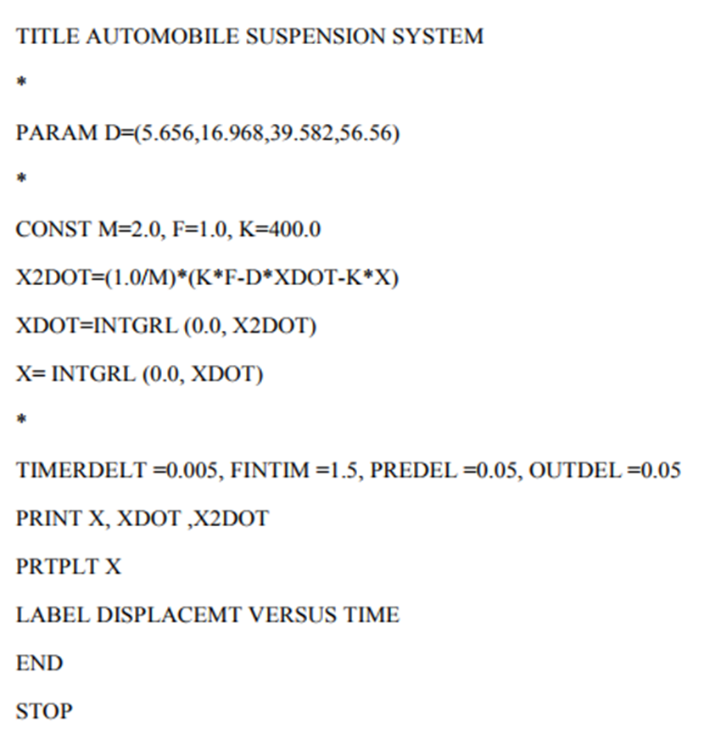

Slide 69
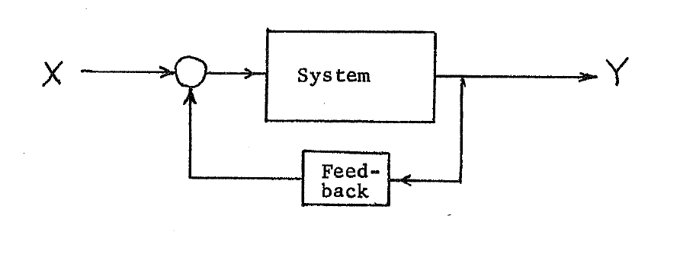
Feedback System
Feedback occurs when outputs of a system are routed back as inputs as part of a chain of cause-and-effect that forms a circuit or loop.
The system can then be said to feed back into itself.
Figure: Feedback System

Slide 70
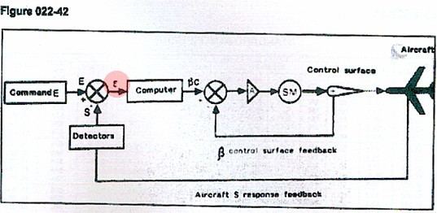

Slide 71
Interactive System
Interactive systems are computer systems characterized by significant amounts of interaction between humans and the computer.
It is a computer device made up by a CPU and peripherals, whose functioning requires a constant interaction with the user.
Most users have grown up using Macintosh or Windows computer operating systems, which are prime examples of graphical interactive systems.
Editors, CAD-CAM (Computer Aided Design-Computer Aided Manufacture) systems, and data entry systems are all computer systems involving a high degree of human-computer interaction.
Games and simulations are interactive systems.
Web browsers and Integrated Development Environments (IDEs) are also examples of very complex interactive systems.

Slide 72
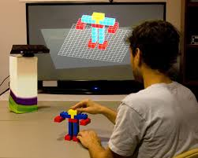
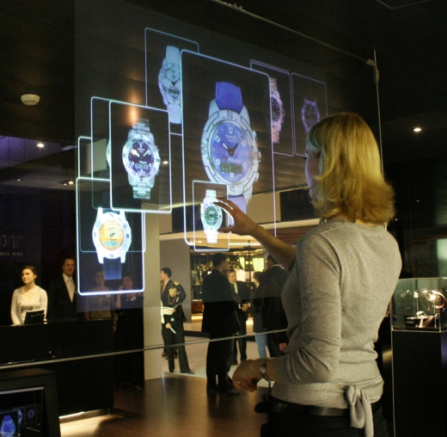

Slide 73
Real Time Simulation
Real-time simulation refers to a computer model of a physical system that can execute at the same rate as actual "wall clock" time.
In other words, the computer model runs at the same rate as the actual physical system. For example, if a tank takes 10 minutes to fill in the real-world, the simulation would take 10 minutes as well.
Real-time simulation occurs commonly in computer gaming, but also is important in the industrial market for operator training and off-line controller tuning.
Computer languages like LabVIEW, VisSim and Simulink allow quick creation of such real-time simulations and have connections to industrial displays and Programmable Logic Controllers .
Several real-time simulator are available on the market like xPC Target and RT-LAB for mechatronic systems and using Simulink, eFPGAsim and eDRIVEsim for power electronic simulation and eMEGAsim, HYPERSIM and RTDS for power grid real-time.

Slide 74
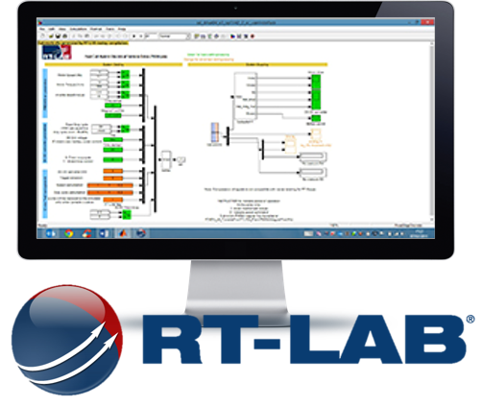
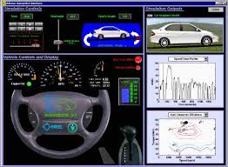

Slide 75
Predator Pray Model Lotka–Volterra equations
The Lotka–Volterra equations, also known as the predator–prey equations, are a pair of first-order, nonlinear, differential equations frequently used to describe the dynamics of biological systems in which two species interact, one as a predator and the other as prey.

Slide 76
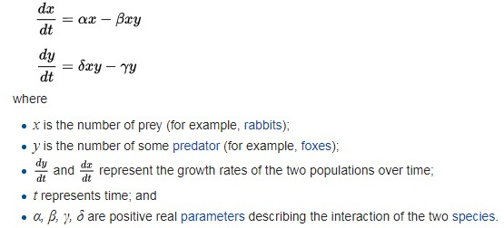
The populations change through time according to the pair of equations:

Slide 77
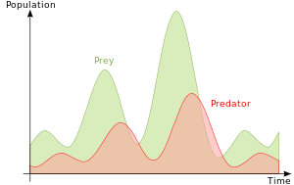

Slide 78
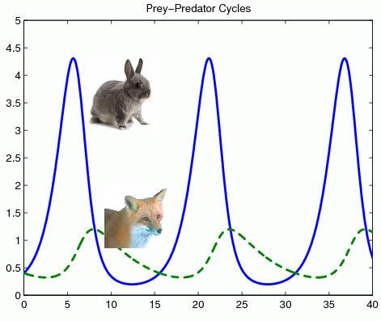

Slide 79
